Slide 1
Battle of the Neighbourhoods Toronto vs New York City for The best location for the best organization.
- Pankaj Kumar

Slide 2
Index
Problem statement
Objective
Data Acquisition
Solution Case
Results
Conclusion

Slide 3
PROBLEM STATEMENT
Understand the similarities and differences of neighbourhoods between scarborough borough in toronto and queens borough in New York city . select the best neighbourhood for an organization to move its headquarters based on venues.

Slide 4
OBJECTIVE
Collect the neighbourhoods top venues using foursquare.
Form neighbourhood, based on venue categories using unsupervised k-means clustering algorithm.
Identify and understand the similarities and differences between scarborough and queens neighbourhoods to obtain insights into the neighbourhoods.

Slide 5
DATA ACQUISITION
The data used for this project will be acquired from the respective cities wikipedia website pages. The datasets consists of the postal codes, neighbourhood names, latitude, and longitude information for each neighbourhood. Foursquare API search feature will be used to collect neighbourhood venue information. Details about local venues and locality will be provide insight into the qualities of A neighbourhood. In addition to foursquare, various python packages will be used to create maps and machine learning models to further provide insights into our neighbourhood battle project.
Here we collect the neighbourhoods top venues using foursquare form neighbourhood based on venue categories using unsupervised k-means clustering algorithm.
I used the following datasets from these websites:
Toronto neighbourhoods - https://en.Wikipedia.Org/wiki/list_of_postal_codes_of_canada:_m.
Toronto latitude and longitude - http://cocl.Us/geospatial_data
New york city neighbourhoods - https://geo.Nyu.Edu/catalog/nyu_2451_34572
New york city latitude and longitude = python geolibrar .

Slide 6
HOW IT WILL BE USED TO SOLVE THE PROBLEM.
This project will analyse neighbourhoods between toronto, canada and New York city, New York. For an organization is looking to move its headquarters to either toronto or New York. The company wants insight into the neighbourhoods and local businesses in the cities so that its employees may have the optimum living standards and quality of life for family and himself. This project will explore the similarities and dissimilarities between certain neighbourhoods in the two cities, and determine which neighbourhoods best fit the culture of the organization for employees.

Slide 7
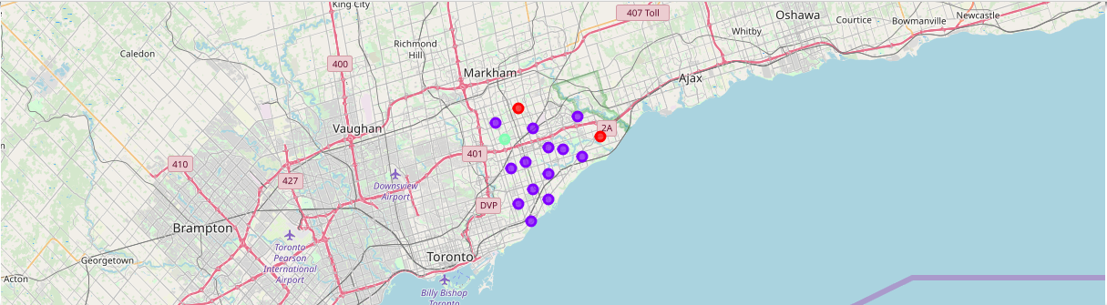
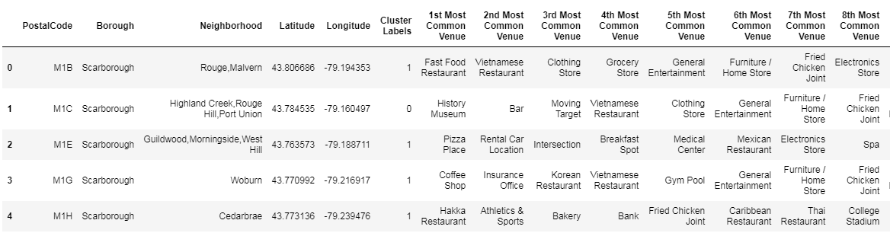
Map of Scarborough
in Toronto using k-means
Different neighbourhood clusters

Slide 8
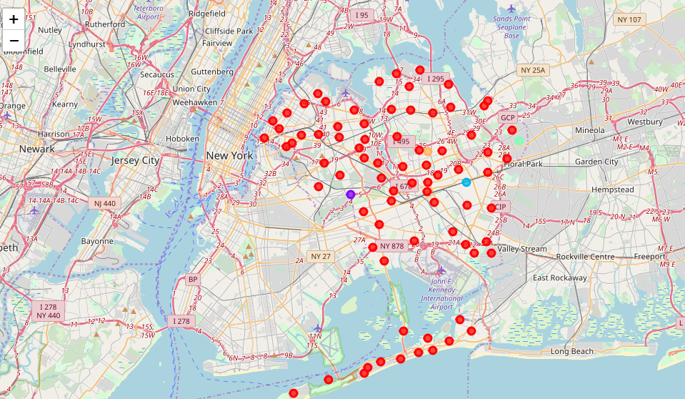
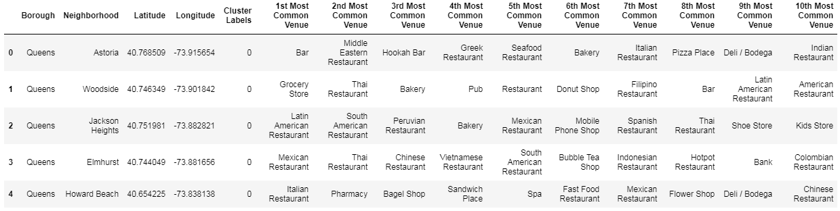
Map of
Queens
In New York City
Different neighbourhood
clusters

Slide 9
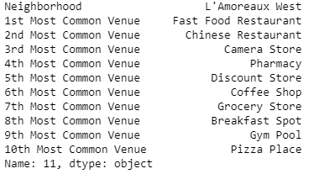
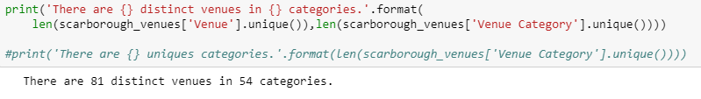
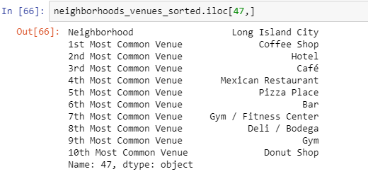

Comparison between Neighbourhoods
Scarborough vs Queens
Scarborough has 81 distinct venues in 54 categories
The most common venues in Scarborough are coffee
shops, international restaurants, and Pharmacy
Queens has 1805 distinct venues in 269 categories
The most common venues in Queens are bodegas,
bakeries, coffee shops, and parks

Slide 10
Conclusion
Based on the quantity of venues and variety of venues, Queens is a better choice than Scarborough to relocate the headquarters of the organization.
Queens offer a greater amount of gyms, grocery stores, restaurants for individual and families of the employees.

Slide 11
Thank you

